Slide 1



“SAMVED” HACKATHON 2026
Problem Statement ID – PS-001
Problem Statement Title-Smart Road Damage Reporting & Rapid Response System for Solapur Municipal Corporation.
Theme-Smart Streets, Safer Solapur
Team ID-698346798b8527536642529a
Team Name - TEAM VIKINGS

Slide 2

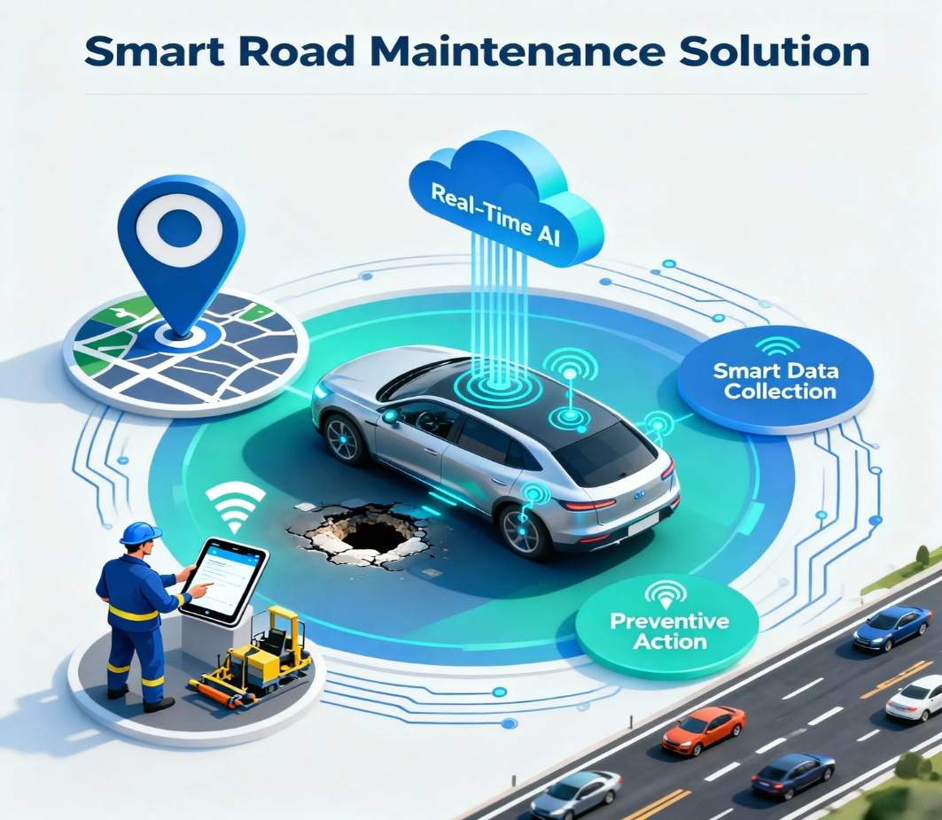
Smart Road Damage Reporting & Rapid Response System for Solapur Municipal Corporation
Solution
1️⃣ Smart Data Collection
Sensors on vehicles & roads detect potholes and bumps
Uses smartphones & public vehicles → low cost
2️⃣ Real-Time AI Analysis
Data sent to cloud instantly
AI classifies roads: Good | Moderate | Poor
3️⃣ Live Map & Dashboard
Shows exact location, severity & time of damage
Helps plan faster, smarter repairs
4️⃣ Alerts & Preventive Action
Instant alerts to authorities & repair teams
Fixes roads before accidents happen
5️⃣ Public Safety & Smart Cities
Integrates with navigation apps
Safer travel, smoother roads, longer road life.
ADRESSING THE PROBLEM
1️⃣ Early Detection
Detects potholes & cracks early → Prevents accidents & major damage
2️⃣ Automated Monitoring
Sensors & cameras monitor continuously → Faster, accurate road checks
3️⃣ Smart Repairs
GPS & severity info guide maintenance → Quick & cost-effective repairs
4️⃣ Safer Roads
Real-time alerts for sudden damage → Fewer accidents & vehicle damage
Innovation & Uniqueness of the Solution
1️⃣ Roads That Report Themselves
Sensors automatically detect road damage
No need to wait for public complaints
2️⃣ Real-Time, Not After Damage
Detects potholes as soon as they appear
Prevents accidents before they happen
3️⃣ Built for People
Reduces accidents, vehicle damage & travel stress
Improves daily travel experience for everyone

Slide 3
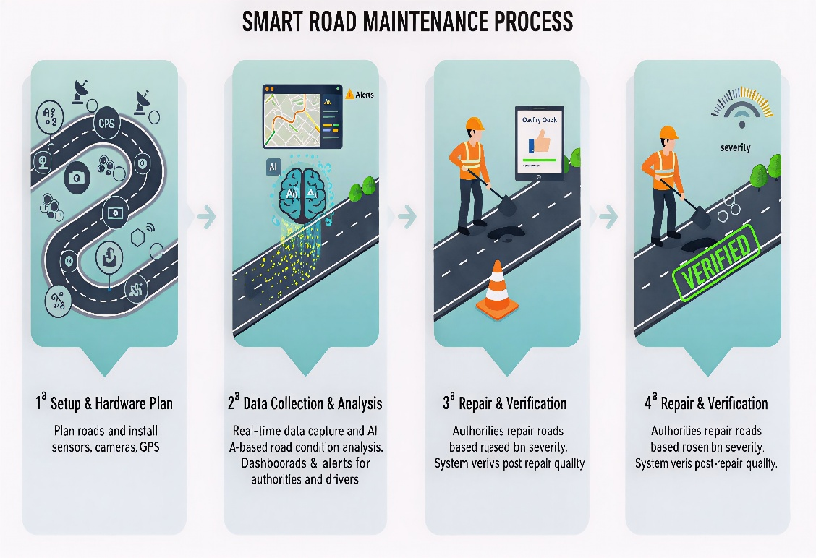
TECHNICAL APPROACH
Technologies Used in the Road Condition Monitoring System
1️⃣ Hardware
Sensors & gyroscope → detect bumps & vibrations
Cameras → capture potholes & cracks
GPS → tracks exact locations
Edge/IoT devices → collect & send data
2️⃣ Software & Programming
Python / C++ → controls sensors & processes data
OpenCV → detects road damage from images
AI/ML → classifies damage automatically
Methodology
1️⃣ Data Collection
Sensors & cameras detect bumps, cracks, and potholes
GPS records exact location
2️⃣ Data Transmission
Real-time upload via 4G/5G or IoT networks
3️⃣ Data Processing & Analysis
AI/ML classifies road condition: Good / Moderate / Poor
Automatic detection of potholes & cracks
3️⃣ Cloud & Data Management
Cloud platforms → store & process data
Databases → manage road records
APIs → integrate with apps & dashboards
4️⃣ Mobile & Web Interface
Dashboards → monitor road conditions
Mobile apps → alert drivers about hazards
5️⃣ Connectivity & IoT
4G/5G or LoRaWAN → real-time data transmission
Edge computing → faster local processing
4️⃣ Visualization & Alerts
Live dashboard for authorities
Mobile alerts for drivers
5️⃣ Maintenance & Feedback
Repairs planned based on severity & location
Post-repair verification ensures quality

Slide 4
FEASIBILITY AND VIABILITY
Feasibility Analysis
1️⃣ Technical
Uses mature sensors, cameras, GPS, and AI/ML — ready to deploy
2️⃣ Economic
Sensors on existing vehicles; AI prioritizes repairs → cost-effective
5️⃣ Scalability
Modular system; can expand city-wide with cloud & IoT
Potential Challenges & Risks
1️⃣ Sensor Accuracy
Environmental factors can cause false or missed detections → reliability issues
2️⃣ Data Privacy & Security
Location & road images must be protected with encryption and secure access
3️⃣ Connectivity Issues
Weak 4G/5G or IoT coverage may delay real-time alerts
4️⃣ High Setup Cost
Installing sensors & devices city-wide needs significant investment
5️⃣ Maintenance & Updates
Sensors and AI models require regular maintenance and software updates
3️⃣ Operational
Integrates with municipal workflows; real-time alerts for faster action
4️⃣ Social
Safer roads → fewer accidents, protected vehicles, happier commuters
Strategies to Overcome Challenges
1️⃣ Sensor Accuracy
Combine sensors + AI filtering & regular calibration → reduce false alerts
2️⃣ Data Privacy & Security
Encrypt data, control access, anonymize visuals → protect user privacy
3️⃣ Connectivity Issues
Store data locally when offline & auto-upload later → no missed alerts
4️⃣ High Setup Cost
Use existing vehicles/devices, start small → scale smartly
5️⃣ Maintenance & Updates
Regular hardware checks + cloud-based software updates → smooth operation

Slide 5
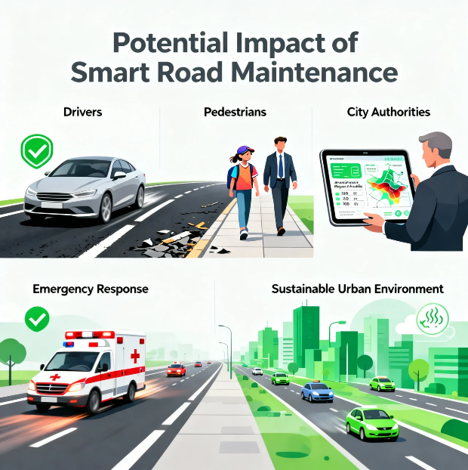
IMPACT AND BENEFITS
Potential Impact on the Target Audience
🚗 Drivers & Commuters – Avoid potholes & bumps → fewer accidents, less vehicle damage, smoother rides
🏫 Students & Professionals – Reliable roads → safer, faster, stress-free daily travel
🏛️ Authorities & Maintenance Teams – Real-time data → smarter repairs, faster decisions, better use of funds
🚑 Emergency Services – Safer roads → quicker response times
🌍 Society – Less congestion & pollution → safer cities, improved quality of life
Benefits of the Road Condition Monitoring System
🌟 Social – Safer roads, smoother commutes, more public trust Catchline: “Safer roads, happier journeys.”
💰 Economic – Lower repair costs, fewer vehicle damages, saved time Catchline: “Save money, save time.”
🌍 Environmental – Less congestion & pollution, longer-lasting roads Catchline: “Cleaner air, greener roads.”
🚀 Community Impact – Boosts smart city initiatives & quality of life Catchline: “Better roads today, better cities tomorrow.”

Slide 6
RESEARCH AND REFERENCES
References & Related Research Work
1️⃣ Smartphone & Sensor-Based Road Monitoring
Research shows that accelerometers, gyroscopes, and GPS in smartphones can accurately detect potholes and road roughness. 🔗 https://www.mdpi.com/1424-8220/18/11/3845
2️⃣ AI-Based Pothole Detection Using Images
This work uses computer vision and machine learning to detect potholes and cracks from road images. 🔗 https://pmc.ncbi.nlm.nih.gov/articles/PMC7583950/
3️⃣ IoT-Based Pothole Detection System
Demonstrates an IoT + cloud + GPS approach for real-time pothole detection and reporting. 🔗 https://ijerst.org/index.php/ijerst/article/view/1293
4️⃣ Road Condition Monitoring Using Smart Sensors & AI (Review Paper)
A comprehensive review of sensor-based, AI-driven road monitoring systems and smart city integration. 🔗 https://www.mdpi.com/1424-8220/22/8/3044
5️⃣ Crowd-Sensing & Multi-Sensor Road Damage Detection
Explains how data from multiple vehicles and sensors improves accuracy and scalability. 🔗 https://www.sciencedirect.com/science/article/pii/S1574119216301262

